Slide 1
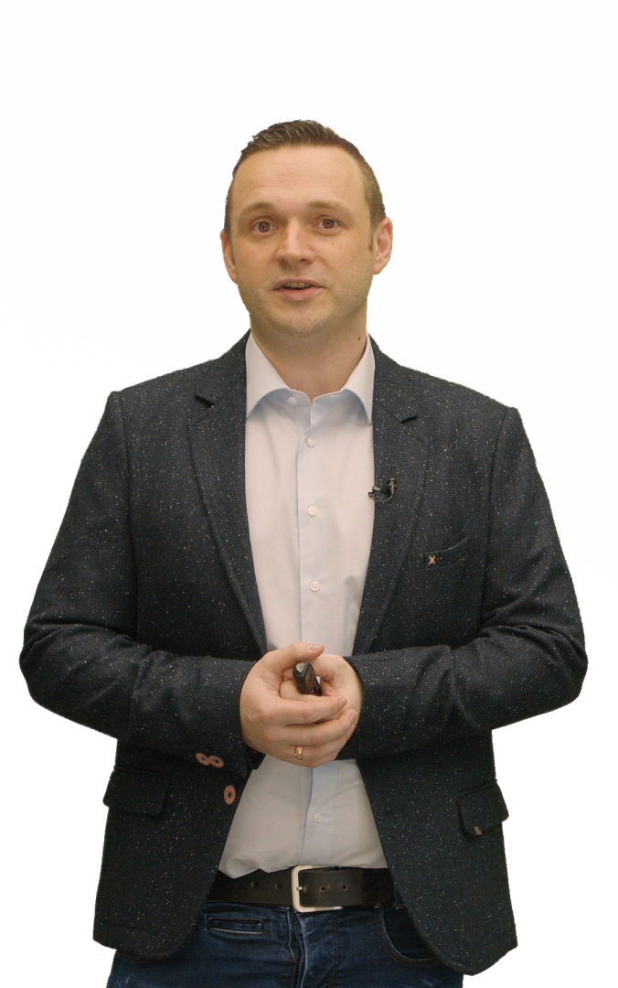
Erfolgsfaktor
Bewegtbild
Videomarketing-Strategie​
Social Media-Content
Produkt- und Erklärvideos
Online-Events

Slide 2
Schnell &
professionell.
Einfache Steuerung
Hohe Bildqualität
Sauberer Ton
Festpreis-Garantie

Slide 3
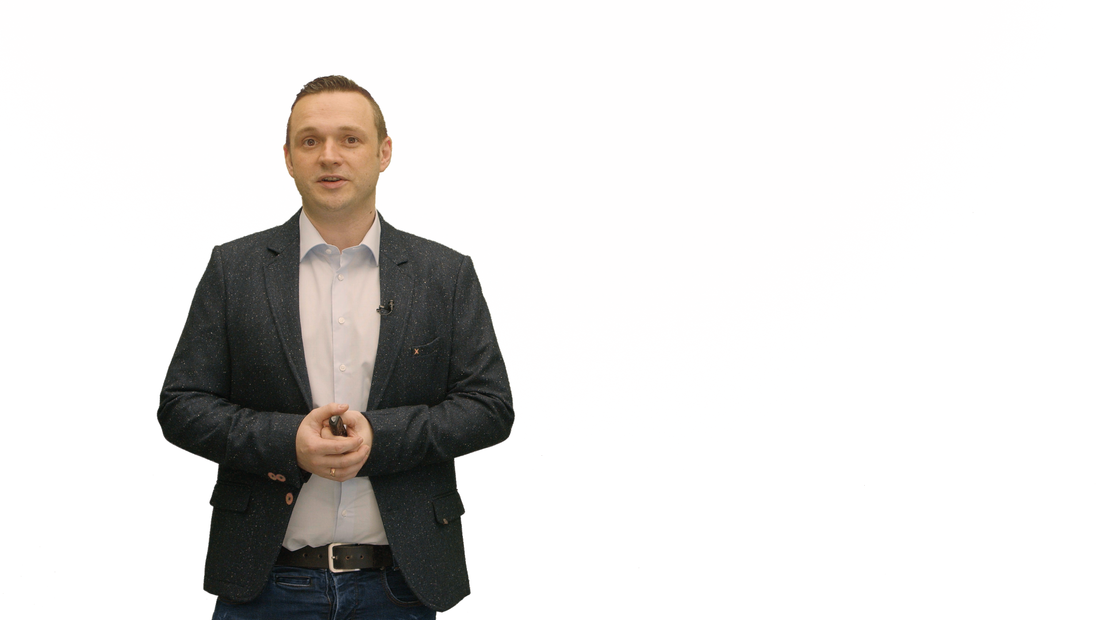
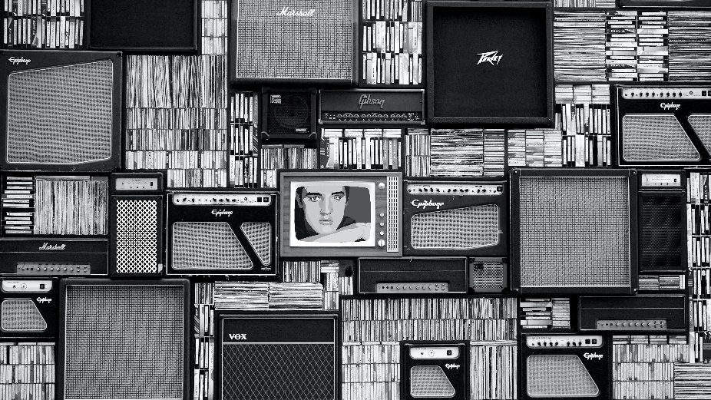
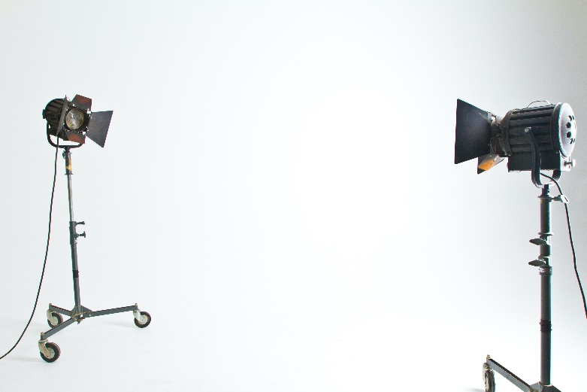
Bilder sagen mehr als tausend Worte!
Zeigen Sie Bilder Ihrer Produkte!

Slide 4
Mit Videos oder Animationen Aufmerksamkeit erregen

Slide 5
Fakten schaffen!
01
02
03
Ihre Überschrift
Ihre Überschrift
Ihre Überschrift
A peep at some distant orb has power to raise and purify our thoughts like a strain of sacred music, or a noble picture, or a passage from. A peep at some distant orb has power to raise. A peep at some distant orb has power to raise and purify our thoughts like a strain of sacred music, or a noble picture, or a passage from the grander poets.
A peep at some distant orb has power to raise and purify our thoughts like a strain of sacred music, or a noble picture, or a passage from. A peep at some distant orb has power to raise. A peep at some distant orb has power to raise and purify our thoughts like a strain of sacred music, or a noble picture, or a passage from the grander poets.
A peep at some distant orb has power to raise and purify our thoughts like a strain of sacred music, or a noble picture, or a passage from. A peep at some distant orb has power to raise. A peep at some distant orb has power to raise and purify our thoughts like a strain of sacred music, or a noble picture, or a passage from the grander poets.

Slide 6
Hier wird´s Zeit.
02521 826 44 14
info@vimemo.de

Slide 7
Die Richtung bestimmen
01
A peep at some distant orb has power to raise and purify our thoughts like a strain of sacred music, or a noble picture, or a passage from.
03
Write option name
02
Write option name
Write option name
A peep at some distant orb has power to raise and purify our thoughts like a strain of sacred music, or a noble picture, or a passage from.
A peep at some distant orb has power to raise and purify our thoughts like a strain of sacred music, or a noble picture, or a passage from.

Slide 8
Vielen Dank!

